Slide 1
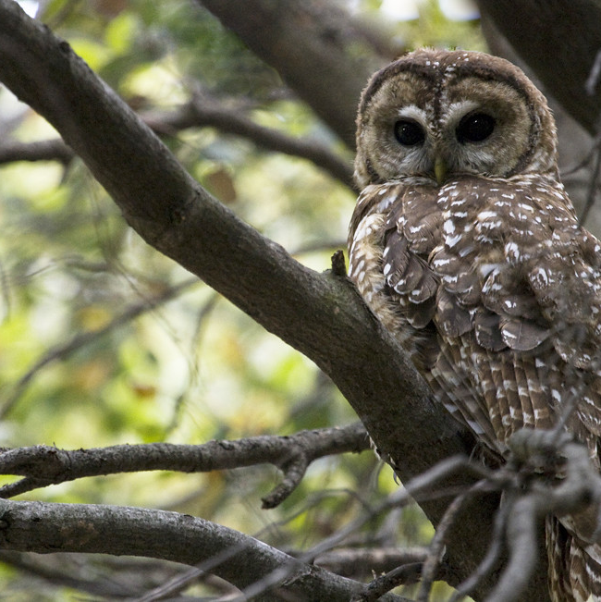
Mapping critical habitat of the Mexican spotted owl and its exposure to mining, Roads, and Urban areas
Presented by Meghan Boniecki, Lindsay Polaski, Chase Ingersoll

Slide 2
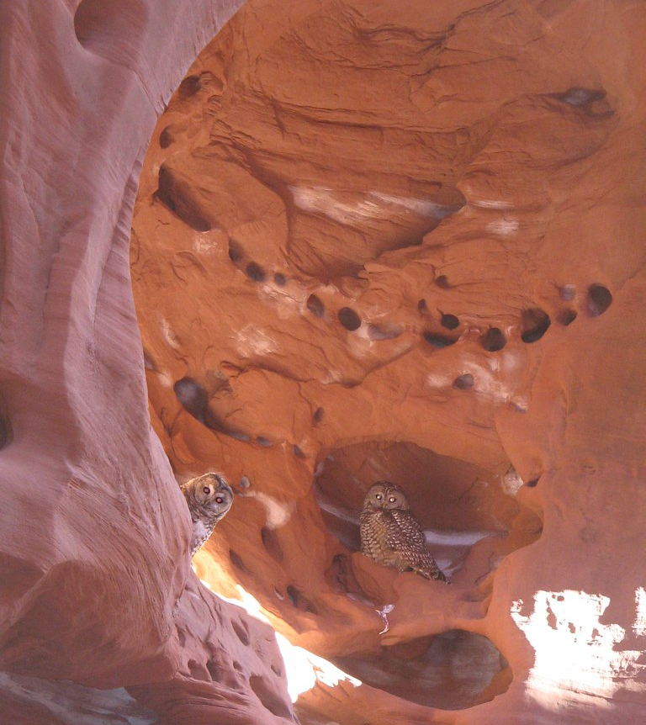
Mexican Spotted OWl
Scientific Name: Strix Occidentalis Lucida.
One of the largest owls & rarest in North America.
Range & Distribution: Colorado, New Mexico, Utah, Arizona, Western Texas, and Northern Mexico
Habitat Requirements: high elevations (4,100-9,000 ft), old-growth mixed-conifer forests, riparian features, and steep walled canyons
Conservation Status: threatened
Biggest Threats: habitat fragmentation & loss, mining logging, wildfires, human activity, and urban development

Slide 3
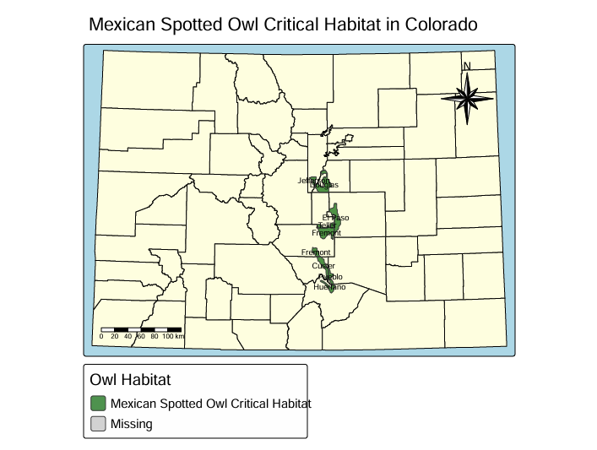
Introduction
Study Area: Colorado
Research Question: Where are owl habitats being protected, and where are they most vulnerable to human disturbance in Colorado?
Project Goals:
Understanding what mining types dominate the owl's critical habitat
Visualizing which roads overlap the owl's habitat the most
Discovering if large urban areas overlap with owl habitat
To find what areas should be protected the most for owl habitat conservation, and what areas pose the most risk to owl habitat
This map shows what counties contain owl habitats and how many meters squared of habitat is located in the county. This map is useful because it gives a clear indication of where exactly the habitat is located and what county contains the most squared meters of habitat.

Slide 4
Methodology& Workflow
Spatial Analysis in RStudio​
Mapped owl habitat boundaries​
Identified mines, major roads within habitat zones​, and urban development
Created 2- mile risk buffers​
Calculated habitat regions most at risk​
Produced visualizations (choropleth maps, bar charts, cartograms)​
Purpose of Analysis​
Determine where human activities overlap owl habitat​
Highlight vulnerable areas needing conservation action​
​
Data Collection
Habitat data: U.S. Fish & Wildlife Service
Mining permits: Colorado Division of Reclamation, Mining & Safety
Roads: Data.gov
Counties: Data.gov
Urban data: U.S. Census Bureau
Data Preparation
Cleaned attribute tables
Removed records outside Colorado
Performed spatial joins and intersection

Slide 5
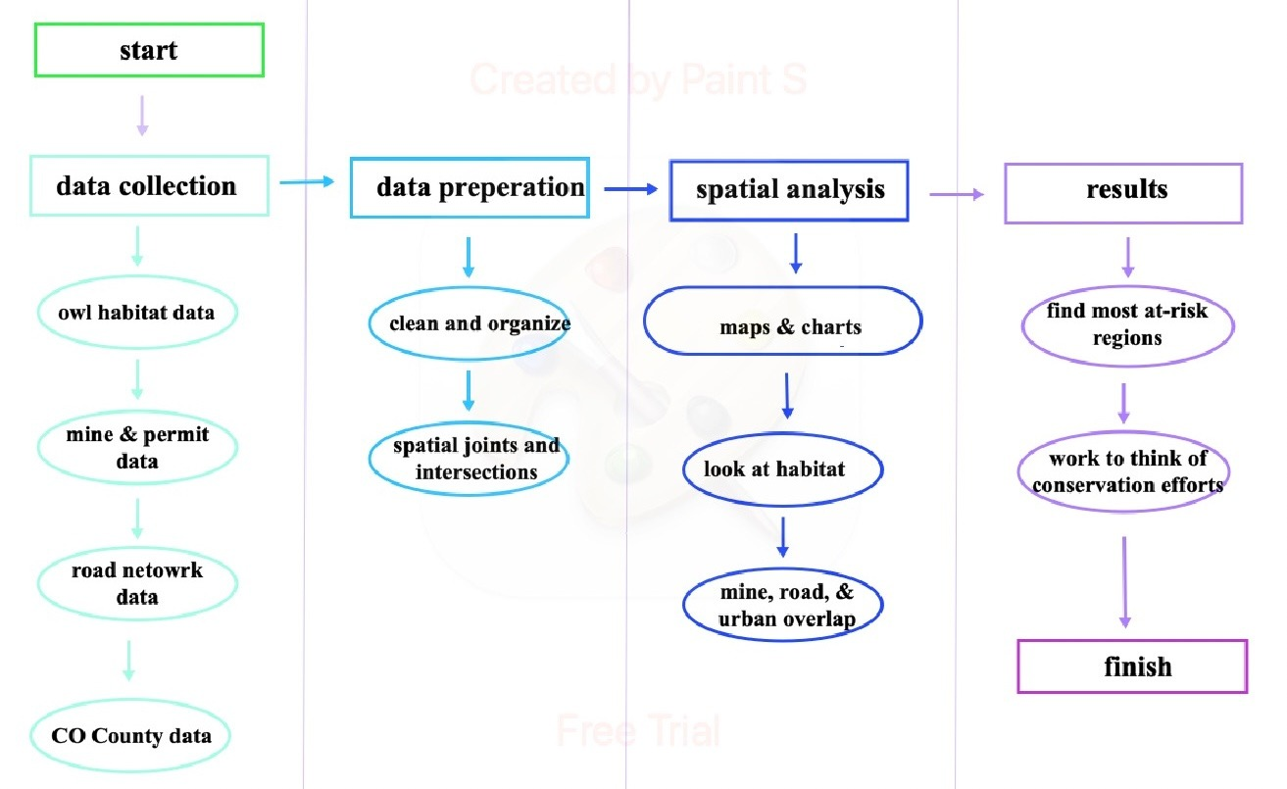
Workflow diagram
Urban data

Slide 6
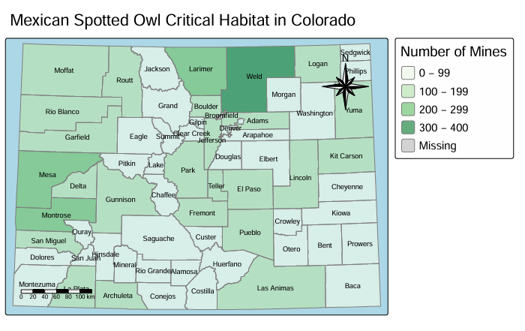
Mining Visualizations
This visualization shows that Weld County contains the highest concentration of mining operations, with many other counties having fewer mines. Within the Mexican Spotted Owl habitat, 31 mines are located inside the habitat boundary.
Even a small number of mines within critical habitat is significant. Mining introduces noise, disturbance, habitat fragmentation, and even vegetation loss that reduce nesting success, limit owl movement, and degrade the old growth forest conditions the owls depend on. As a threatened species, any additional stress from mining activity increases the vulnerability of remaining habitat patches.

Slide 7
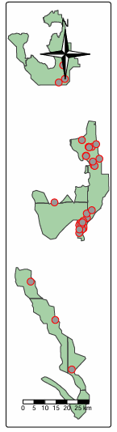
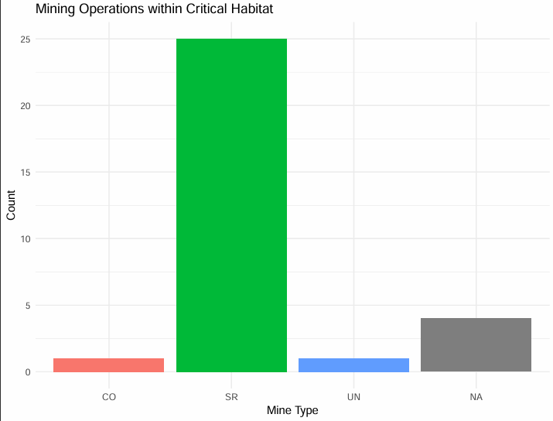
Mining Visualizations
SR: Surface Mines
CO: Coal Mines
UN: Unspecified Mines
N/A: Permit number did not provide mine type
Surface Mining (SR mines) disturb large surface areas, removing vegetation and limiting forest structure that the owl depends on. Mexican Spotted Owls require dense, mature forest canopies for nesting and roosting. Surface mining destroys these essential conditions.
SR mining also creates noise, light, and sustained human activity, which disrupts foraging behavior and reduces nesting success.
Additionally, these mines introduce access roads that fragment the habitat, thus limiting movement between patches. Since nearly all mines inside the habitat are SR mines, their widespread surface disturbance poses the highest risk to the owl’s already limited and sensitive habitat.

Slide 8
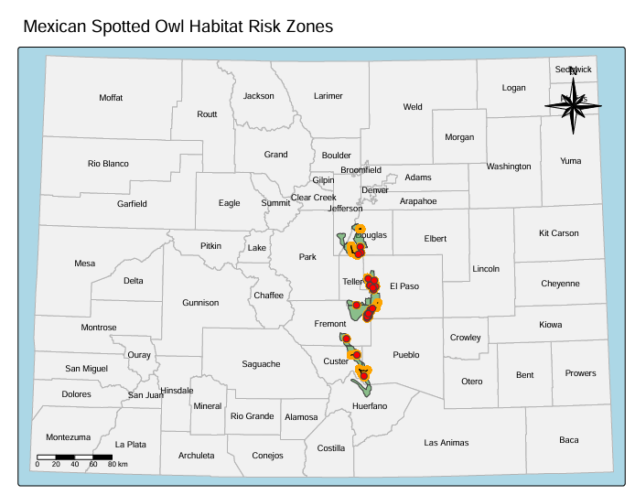
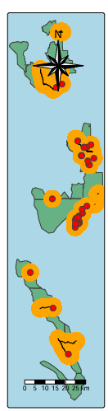
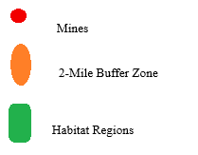
Most At-Risk Habitat Regions
Mines
2.5-Miles Buffer Zone
Habitat Region
This map highlights the areas where Mexican Spotted Owl habitat is most vulnerable to human disturbance. A 2.5-mile buffer around the habitat identifies zones at high risk from nearby development. Within this zone, several active mines and major road networks overlap directly with habitat boundaries. This creates concentrated pressure points for the habitat and the species.
Mines introduce noise, vegetation loss, and fragmentation, while roads increase traffic, light pollution, and limits the movement of the species.
Overall, these factors reduce habitat quality and disrupt nesting and foraging behavior. The map shows how mining operations, transportation corridors, and surrounding development interact to intensify threats to the owl’s remaining habitat patches.

Slide 9
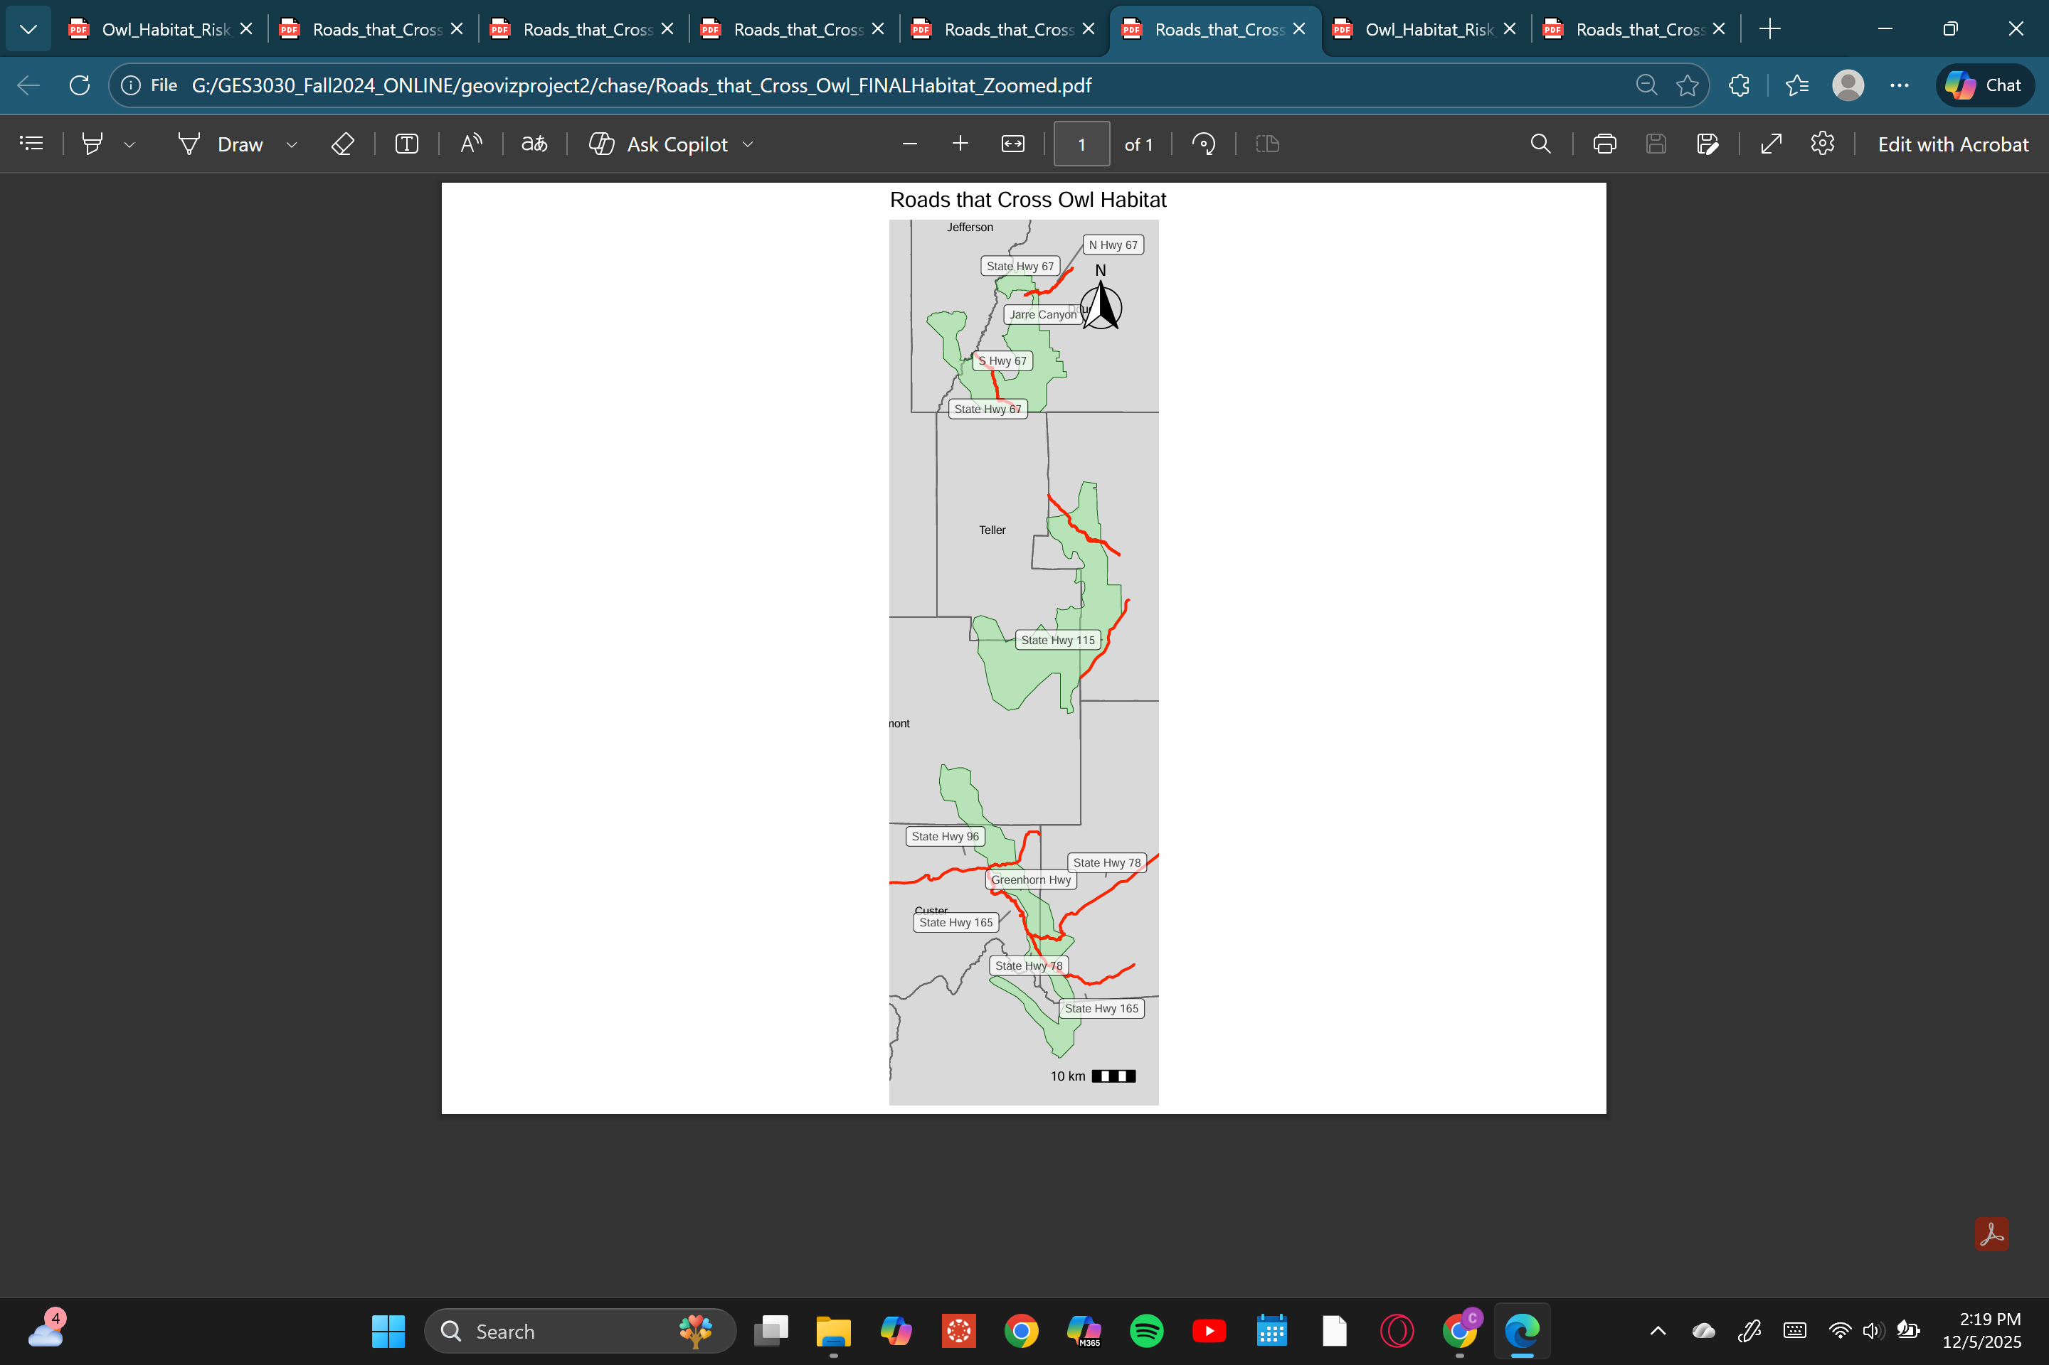
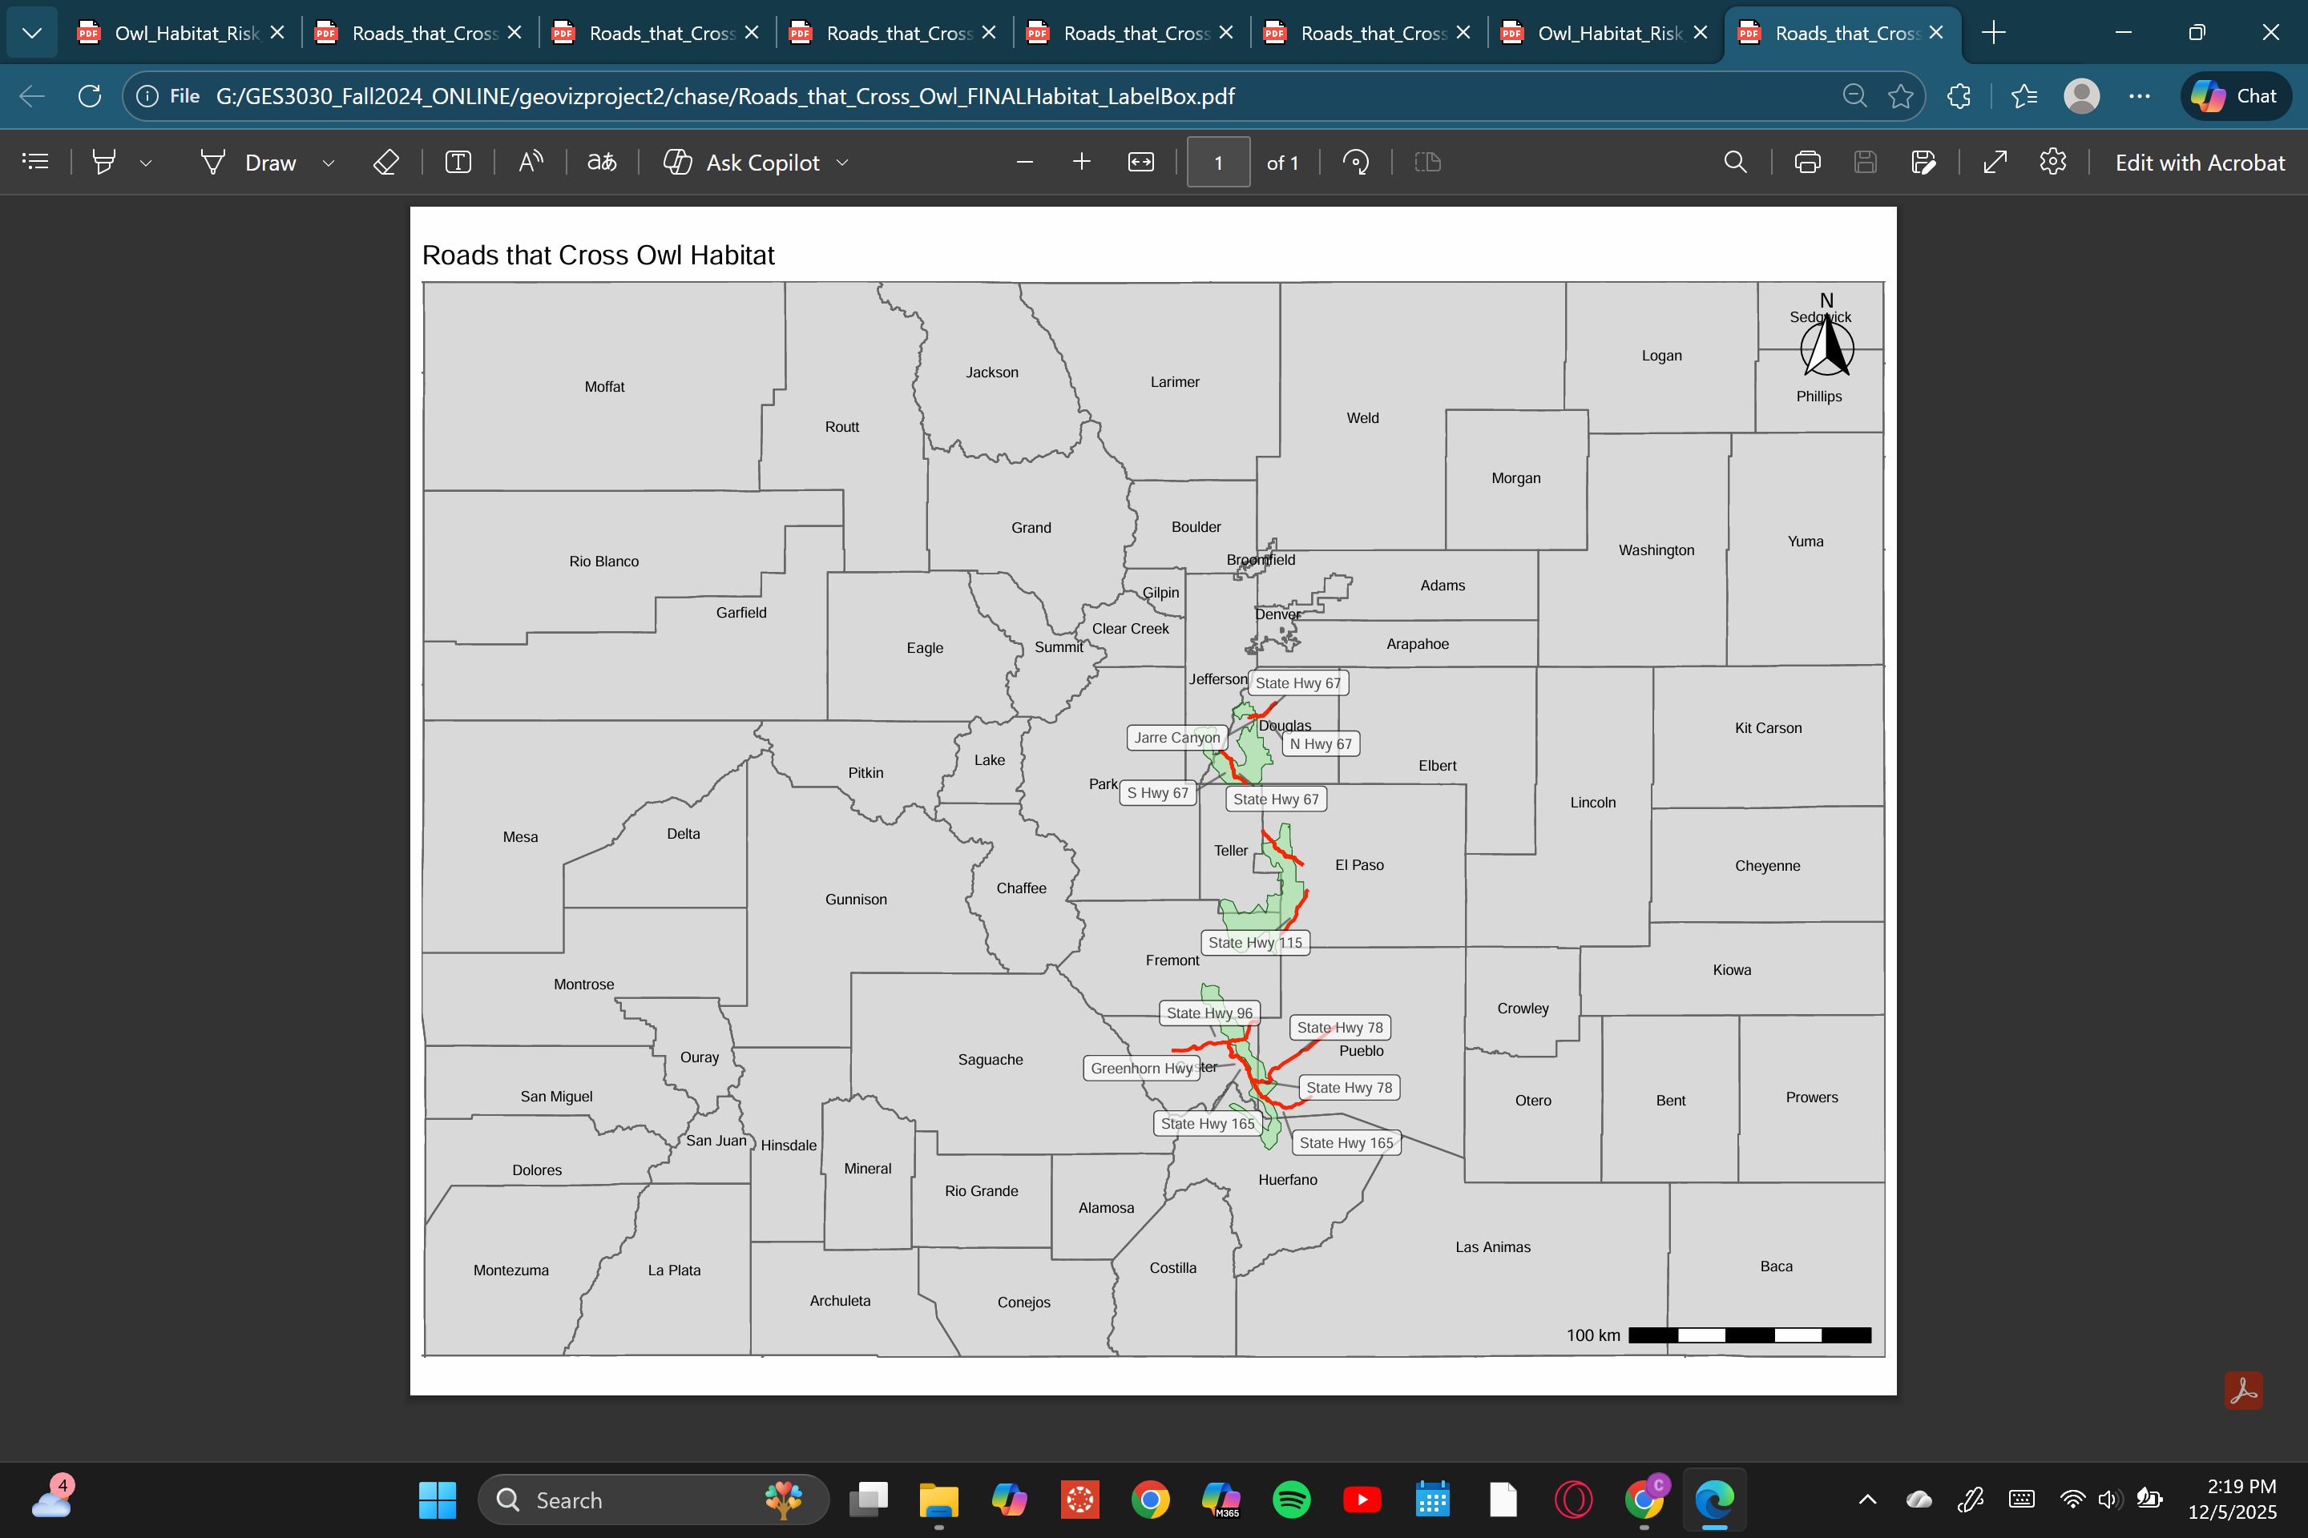
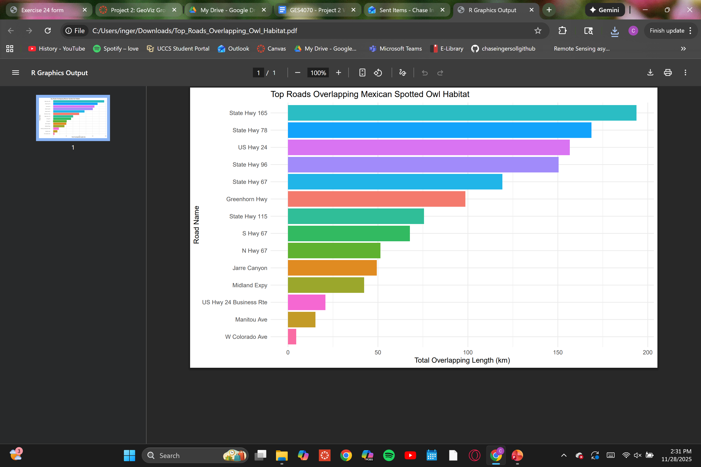
Road Visualizations
The bar chart and choropleth map showcases what roads cross owl habitat.
The development of roads and the human activity associated with urban areas result in habitat fragmentation and degradation, and increased vulnerability to vehicle collisions.

Slide 10
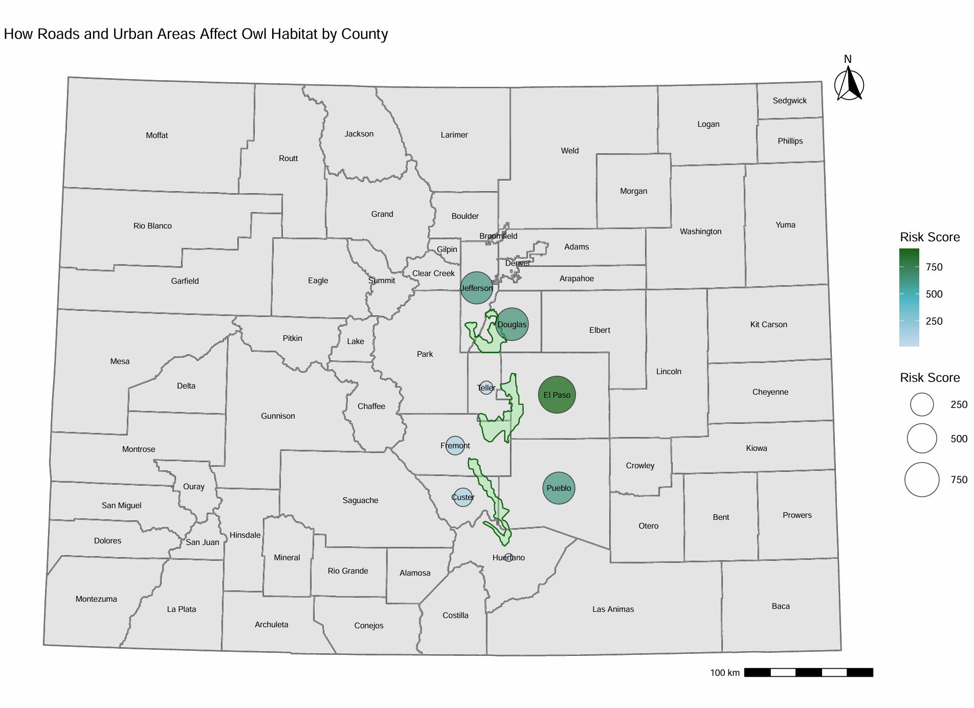
Road Visualizations
The size and color of each circle represents the relative risk to owl habitat in that county, based on habitat area, road density, and urban development.
Larger, darker circles indicate counties where habitat is more heavily impacted by human activitity
Risk score (approx. 250–750): Calculated as 0.1 × habitat area (km²) + road length (km) + urban area (km²); higher values indicate counties where owl habitat is more heavily affected by human infrastructure.

Slide 11
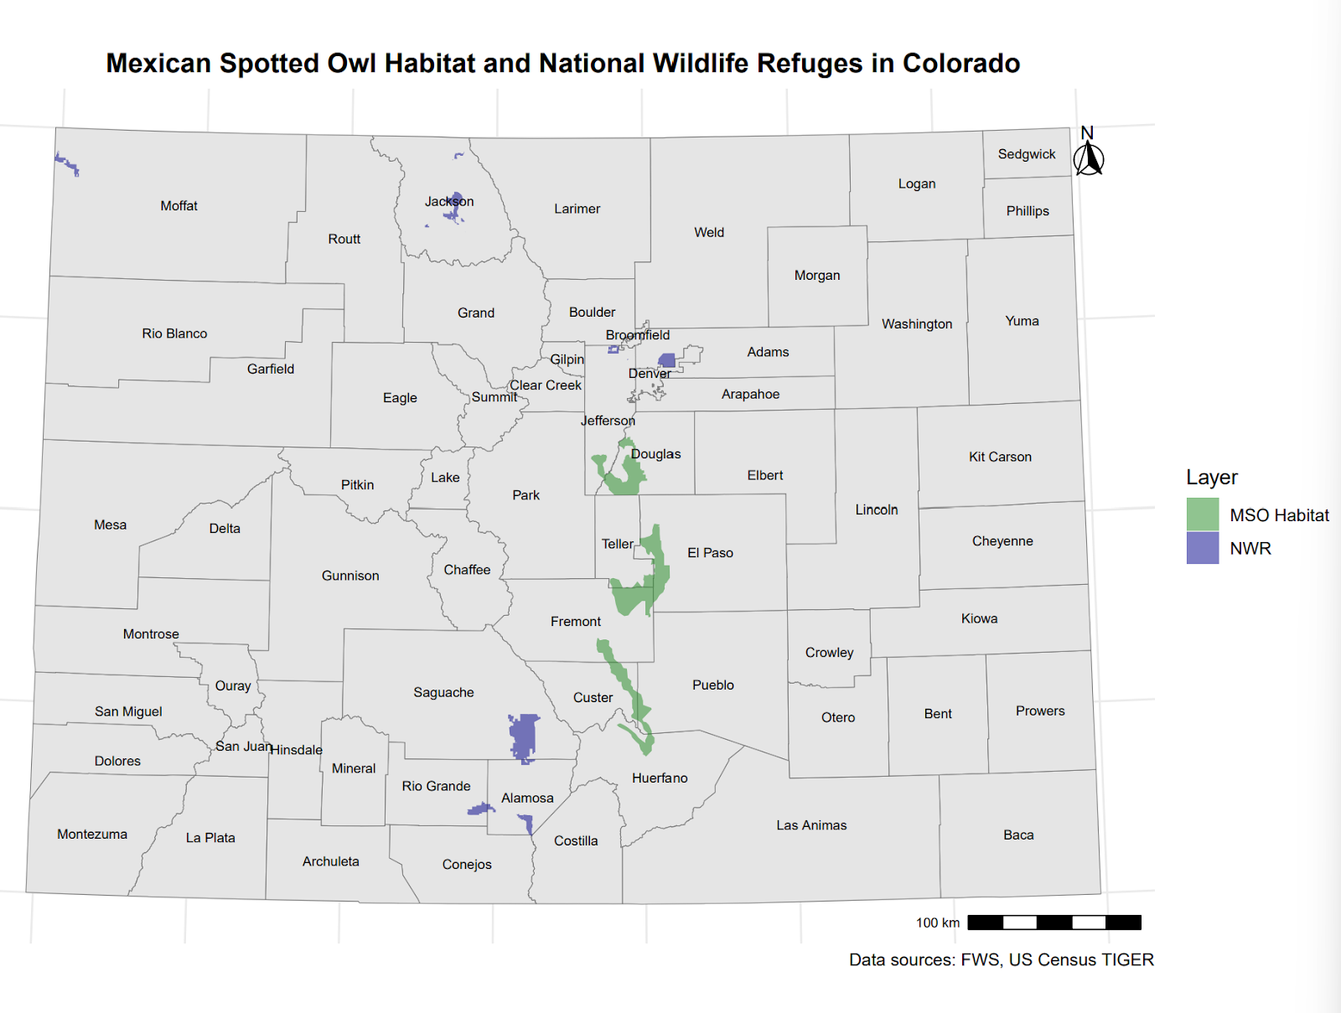
National Wildlife refuge Visualization
The National Wildlife Refuge protects areas of land and water managed by the U.S. Fish and Wildlife Service.
This choropleth map shows where wildlife refuges are in the state of Colorado in comparison to the owl's habitats.
Wildlife Refuges do not overlap with owl habitats meaning the already threatened species is unprotected through the NWR.

Slide 12
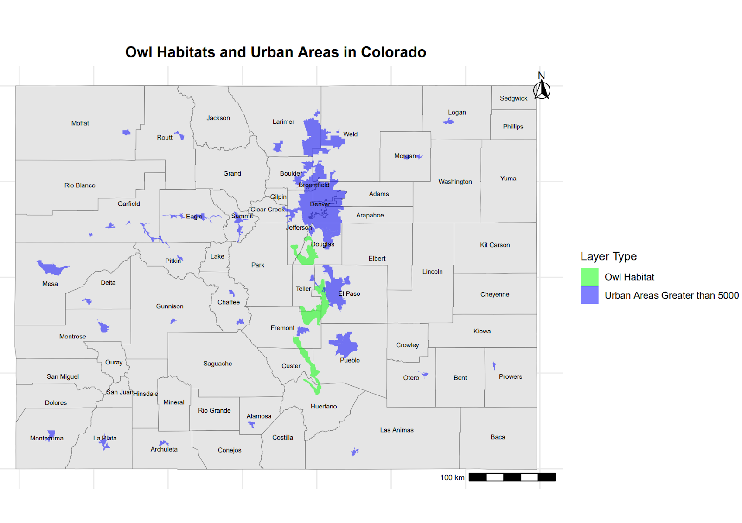
urban areas Visualization
This choropleth map shows where populations larger than 5000 people reside in relation to owl habitats.
El Paso County is within the closest proximity to the owl habitats and poses a major threat to the species because of urban expansion.

Slide 13
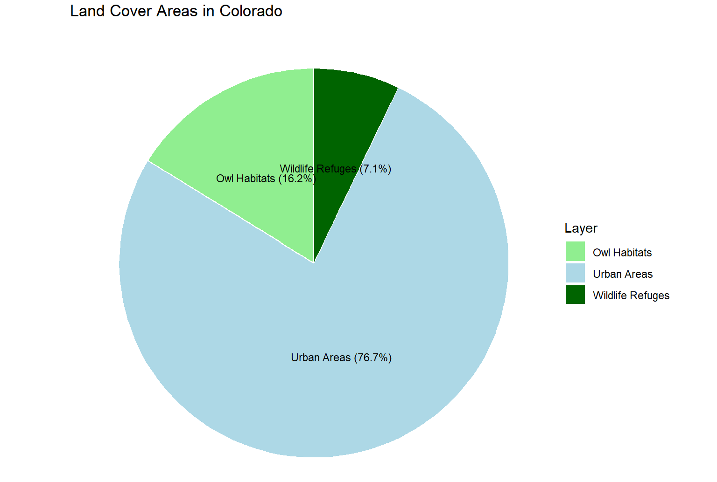
urban areas & wildlife refuge Visualization
This pie chart shows the percentage of land where owl habitats are, percentage of protected land under the National Wildlife Refuge, and percentage of urban areas in the state of Colorado
Uban areas are a much larger percentage of land than protected land and owl habitats.

Slide 14
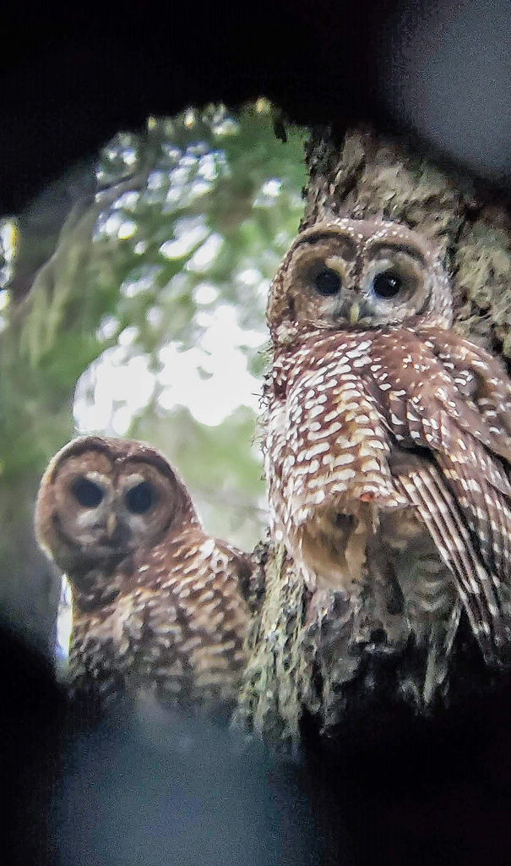
Results & Findings
Habitat: The Largest Owl Habitats are in Fremont, Douglas, and El Paso County
County: El Paso County poses the highest risk to owl habitat due to roads, mines, and urbanization
Roads: State Hwy 165, State Hwy 78, Us Hwy 24 cross their habitat the most
Mining: Surface mining poses the most risk to owl habitats
Urban Sprawl: El Paso County and Douglas County have the largest urban areas in close proximity to owl habitats
National Wildlife Refuge: Does not provide protection for the threatened species

Slide 15
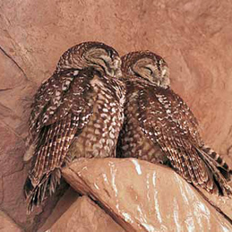
Conclusion
What can we do to conserve the Mexican Spotted owl?
Protect old-growth forest habitats from mining and road development
Limit new route production
Increase wildlife refuge protection areas
Survey new areas before urban development

